Slide 1
POWERPOINT OF
HOW TO LOG ON THE BOOKS YOU HAVE READY SO THAT YOU CAN GET YOUR PRC CERTIFICATE

Slide 2
Premier’s Reading Challenge
The Challenge runs from February to August very year.
Every year, Kingswood Public School students from Kindergarten to Year 6 are encouraged to participate in the NSW Premier’s Reading Challenge, which challenges students to read more often and more widely.
Students ES1 & S1 are required to listen to 30 books Students S2 & S3 are required to read by themselves 20 books - 15 from the set challenge list and 5 of their own choice from January to August each year.
Successfully completing the Premier’s Reading Challenge alone is an incredible achievement in its own right, but completing the challenge over the course of several years requires dedication and application.
Students who complete the challenge in four separate years are awarded with a Gold certificate, while students who complete it over seven receive a platinum certificate. The highest award possible is the Premier’s Reading Challenge Medal, which is only awarded to students who complete the challenge every year from Year 3 to Year 9.

Slide 3
KPS Library books that are part of the challenge have the code written on the inside cover.
Penrith City Library has a great selection of PRC books too. FREE for all residents to join.
The library is adjacent to Penrith Westfields shopping centre.
Penrith City Library

Slide 4
Premier’s Reading Challenge Rules.
Challenge | Number of books needed to complete the Challenge | Minimum number of PRC books for your Challenge | Maximum number of personal choice books | PRC booklist selection
K-2 | 30 | 25 | 5 | K-2 , 3-4 , 5-6 , 7-9
3-4 | 20 | 15 | 5 | 3-4 , 5-6 , 7-9
5-6 | 20 | 15 | 5 | 5-6 , 7-9
7-9 | 20 | 15 | 5 | 5-6 , 7-9

Slide 5
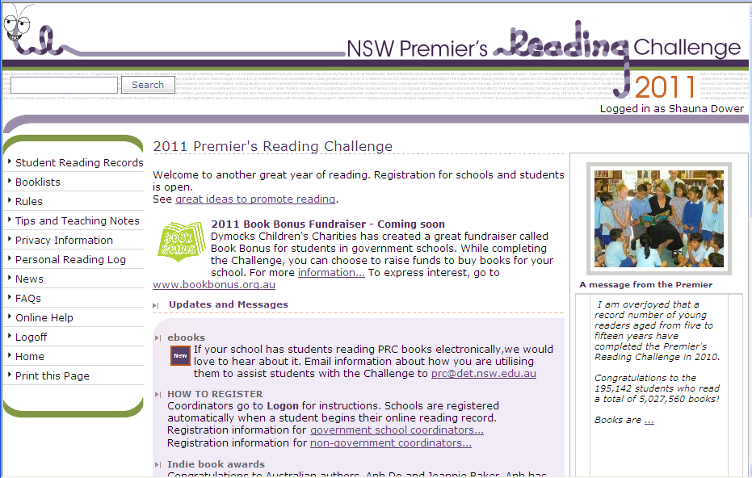
After you’ve successfully logged in, this page will show up on your screen.
This is where you record the books.
Quick way to search for the book code
2020
This is where you get the code for all books in your stage group.
This is where you can print a reading log to write down what your child has read.
This is to log off the website.

Slide 6
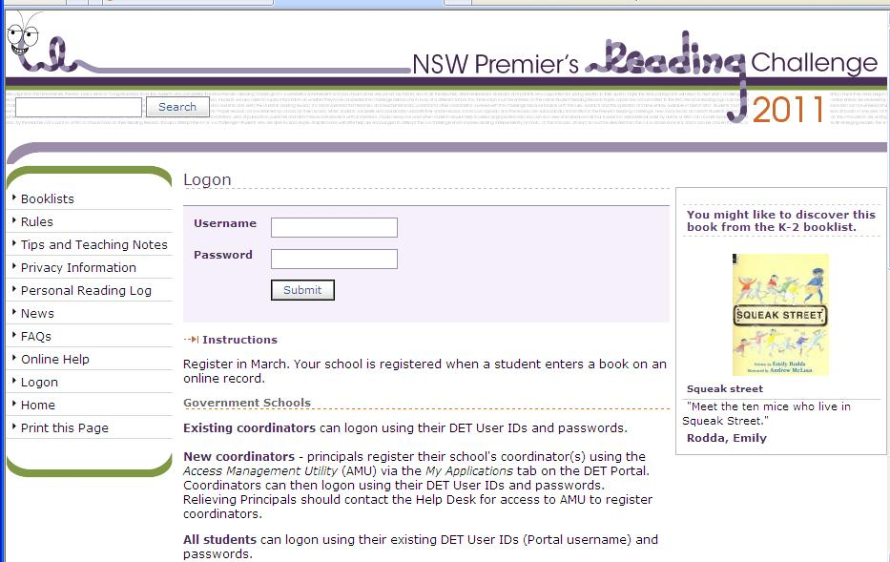
NSW PRC website address: https://online.det.nsw.edu.au/prc/home.html
Username: Your Child’s username is their birth name followed by a dot then your child’s last name. Some will have a number.
For example: If there was a child called Duncan Jones and he was the 4th Duncan Jones registered in the DET, his user name would be duncan.jones4
Teachers will provide log on details to students.
Password:

Slide 7
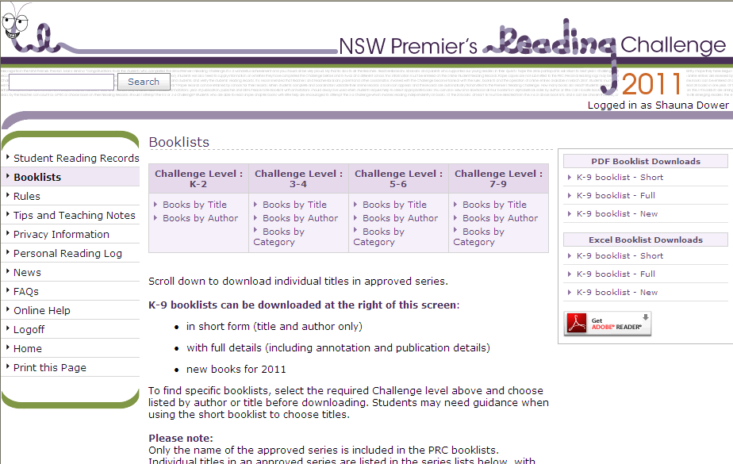
Downloading the Book List .
If you have a school library book the PRC code will be on the inside cover and you don’t need to search here for it.
1. To download the book list you click on book lists while on the front page.
2. Click on the file for your Stage
2020

Slide 8
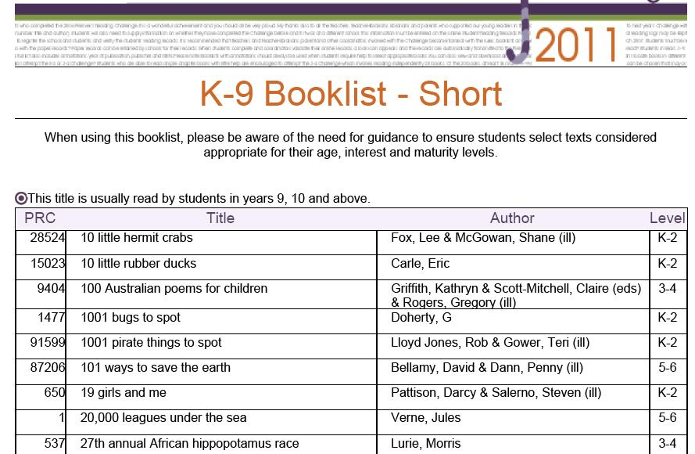
Book List (PDF version).
2020
You can find the book code under this heading.

Slide 9
Once you have got your list and found the book’s code, you can add them to your own records.
2020
Click here.

Slide 10
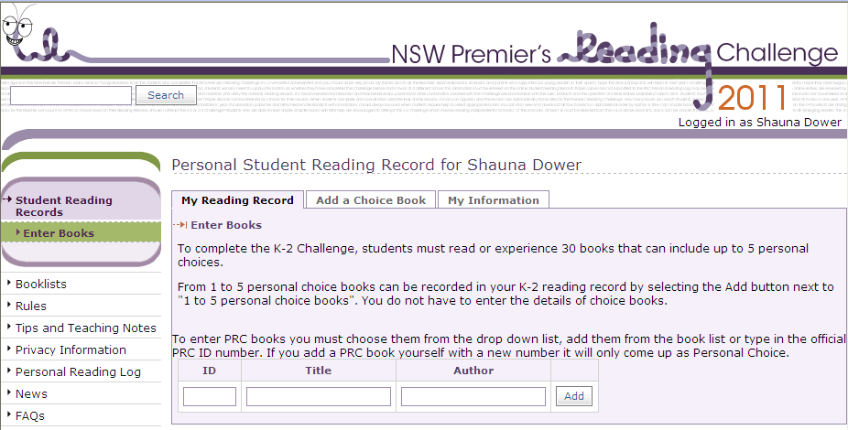
Registering books
2020
Put the ID number in this box or the title in this box.
Click add and your information will appear below as a read book.
If you have a school library book the PRC code will be on the inside cover. Type this code in the ID box and click ADD

Slide 11
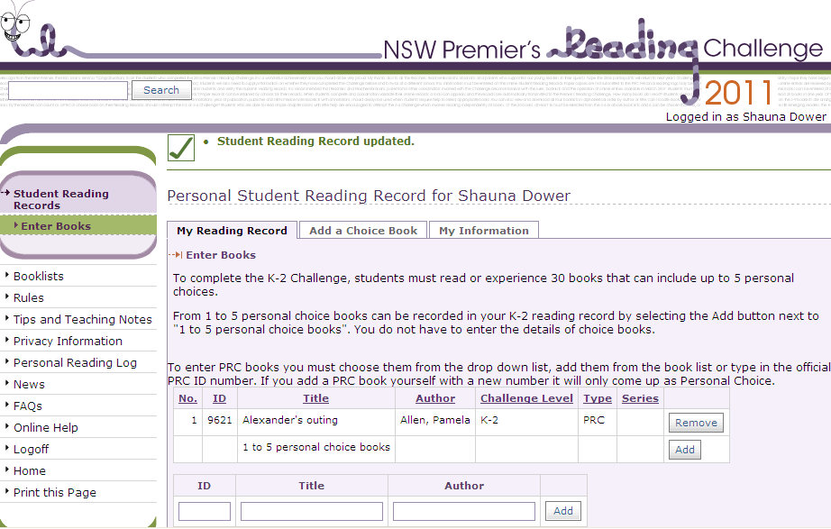
2020
Confirmation that your book was registered.
If you have made a mistake or typed the wrong code you can click on the “REMOVE” button.
When you finished registering, you can log off by just clicking “log off”.

